Slide 1



“AI POWERED
JOB & INTERNSHIP PORTAL”
TUSHAR KUMAR ,SBU221847 ,B-TECH CSE VIII
ABHISHEK KUMAR ,SBU221252 ,B-TECH CSE VIII
SUJEET KUMAR ,SBU221331 ,B-TECH CSE VIII
UNDER THE GUIDANCE OF
DR. MEGHA SINHA
DEPARTMENT OF COMPUTER SCIENCE AND ENGINEERING
SARALA BIRLA UNIVERSITY ,RANCHI ,JHARKHAND ,835103

Slide 2

AI POWERED
JOB & INTERNSHIP
PORTAL

Slide 3
CONTENT
ABSTRACT
INTRODUCTION
IMPLEMENTATION DETAILS
PROJECT WORK
CONCLUSION

Slide 4
ABSTRACT
The process of finding suitable job and internship opportunities often proves to be a significant challenge for candidates, who navigate vast numbers of listings with limited tools for effective filtering and matching. Similarly, recruiters face hurdles in identifying the most qualified candidates efficiently. This project addresses these inefficiencies by developing an "AI-Powered Job & Internship Portal." The primary objective was to create an intelligent, user-friendly platform that leverages Artificial Intelligence to enhance the connection between job seekers and employers.
The portal was developed using a robust technology stack comprising React (with Vite and Mantine UI) for the frontend, Node.js and Express.js for the backend, and PostgreSQL as the database. Key features include secure user authentication for candidates and recruiters, comprehensive job posting and management functionalities, and advanced search capabilities. The core innovation lies in its AI-driven components: a Python-based service utilizing spaCy for Natural Language Processing to automatically extract relevant keywords (skills, technologies) from job descriptions, and a recommendation engine that suggests relevant job opportunities to users based on these keywords and job similarity.
The project successfully culminated in a Minimum Viable Product (MVP) demonstrating all core functionalities, including the AI-powered keyword extraction and job recommendation features. This AI-enhanced approach provides a more intuitive and efficient experience compared to traditional job portals, showcasing the potential of AI in streamlining the recruitment process. Future enhancements could include advanced resume parsing and direct application tracking.

Slide 5
INTRODUCTION

Slide 6


THE CHALLENGE & OUR SOLUTION
THE CHALLENGE
Job seekers face difficulty finding relevant roles in a crowded market.
Traditional portals often lack precise matching and personalization.
Recruiters struggle to find the right candidates efficiently.
OUR SOLUTION
An AI-powered job and internship portal designed to bridge this gap.
Focuses on intelligent matching for both candidates (students, graduates, professionals) and recruiters.

Slide 7





PROJECT OBJECTIVES & KEY FEATURES
Job Management
AI Keyword Extraction
User Authentication
Advanced Job Search
Recruiters can post, update, and manage job listings.
Secure login/registration for Candidates & Recruiters.
Job descriptions automatically tagged with skills.
Candidates can search with filters and keywords.

Slide 8
IMPLEMENTATION
DETAILS

Slide 9



TECHNOLOGY STACK
01
Frontend: React (with Vite) for a dynamic user interface. Mantine UI for a clean and responsive design.
02
Backend: Node.js & Express.js for robust API development.
03
Database: PostgreSQL for reliable and structured data storage.
04
AI Service: Python (spaCy) for Natural Language Processing tasks.
05
Authentication: JWT (JSON Web Tokens) for secure user sessions.

Slide 10

SYSTEM ARCHITECTURE OVERVIEW
Frontend (React App): Interacts with the user, sends requests to the backend.
Backend API (Node.js/Express): Handles business logic, user authentication, interacts with the database and AI service.
PostgreSQL Database: Stores user data, job listings, extracted keywords, etc.
Python AI Service: Receives text (job descriptions) from the backend, performs NLP (keyword extraction), and returns structured data.
Flow: User actions on Frontend -> Backend API -> Database/AI Service -> Backend API -> Frontend.

Slide 11






AI MAGIC (PART 1):
KEYWORD EXTRACTION
What it is: Automatically identifying and extracting key skills, technologies, and relevant terms from job descriptions.
Impact: Enables more accurate job searching, filtering, and forms the basis for recommendations.
Recruiter posts a job.
Job description text is sent to our Python (spaCy) AI service.
The AI service processes the text (using Named Entity Recognition - NER & custom patterns).
Extracted keywords are stored alongside the job in the database.

Slide 12



AI MAGIC (PART 2):
JOB RECOMMENDATIONS
What it is: Providing users with a list of "similar" or "recommended" jobs based on their activity or job details.
Impact: Enhances user experience, helps discover relevant opportunities, and increases engagement.
When a user views a job, its extracted keywords are noted.
The system queries the database for other jobs that share a significant overlap in these keywords.
A list of these relevant jobs is presented to the user.

Slide 13
PROJECT WORK

Slide 14
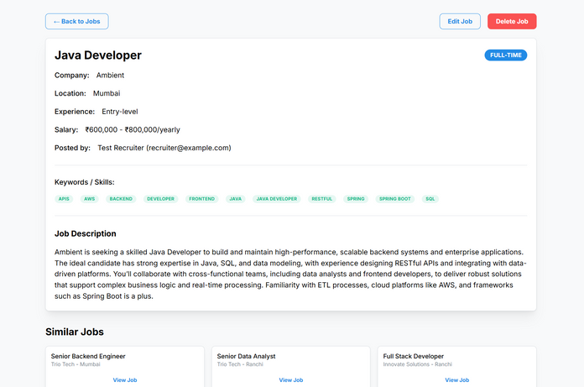
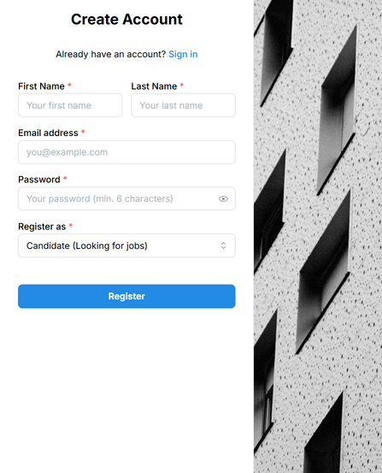
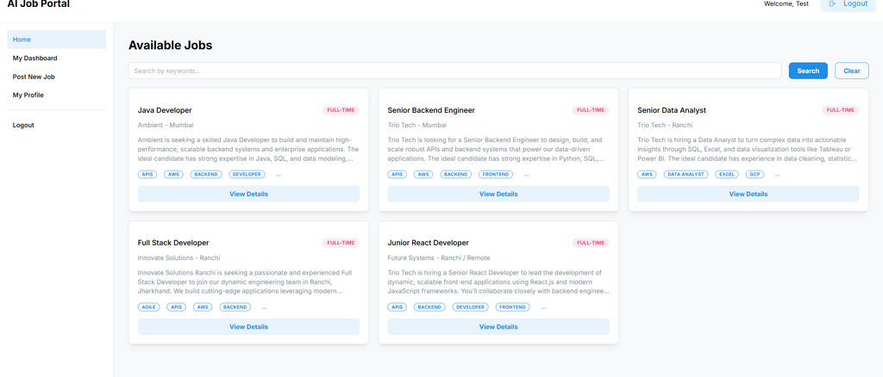
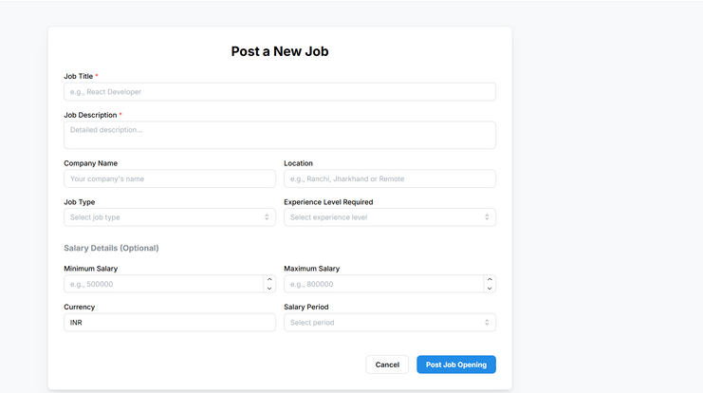

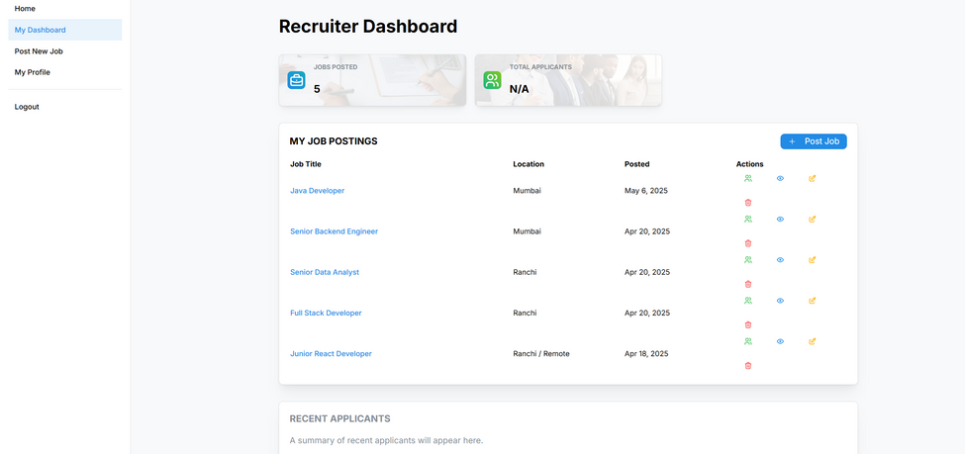
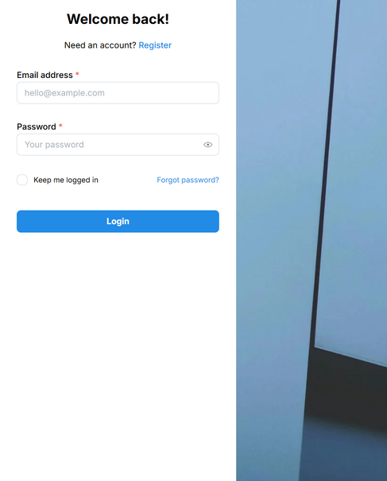
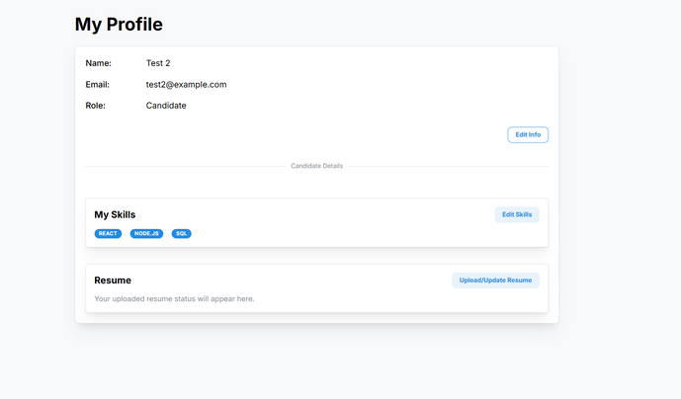
VISUAL SHOWCASE (KEY SCREENSHOTS)

Slide 15

ACHIEVEMENTS & LEARNINGS
Key Achievements:
Key
Learnings:
Successfully developed a full-stack web application with core job portal functionalities.
Integrated two distinct AI features: keyword extraction and job recommendations.
Implemented secure authentication and role-based access control.
Built a user-friendly interface using modern frontend technologies.
Full-stack development process from ideation to MVP.
Practical application of AI (NLP with spaCy) and API integration.
Database design and management with PostgreSQL.
Importance of a structured development plan and problem-solving.

Slide 16


CONCLUSION & FUTURE SCOPE
Conclusion:
Our AI-Powered Job Portal demonstrates a significant improvement over traditional platforms by leveraging AI for smarter matching.
The project successfully meets the core objectives of creating an intelligent and user-friendly system.
Future Scope:
Enhanced resume parsing and candidate profile matching.
Advanced filtering and sorting options.
Company profiles and reviews.
Direct application submission and tracking.

Slide 17

THANK YOU & Q&A

